Slide 1

Cell Aging
By: Donovan Smolich

Slide 2
Objectives
Senescence
Negligible Senescence
Leonard Hayflick
Hayflick Limit
Telomeres
Cancer cells - divide like crazy
Program cell death
Cynthia kenyan - DAF-2 - DAF-16
IGF-1 in mice lifespan
Calories

Slide 3
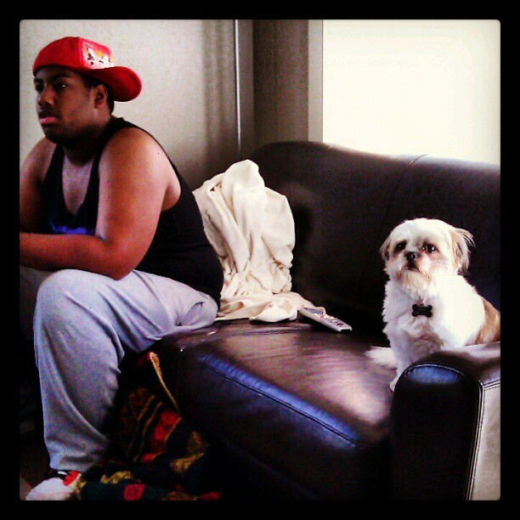

Slide 4
What is Cell Aging?

Slide 5
Cellular aging
Progressive decline in the proliferative capacity and lifespan of cells and effects of continuous exposure to exogenous influences that result in accumulation of cellular and molecular damage
As the cell and its organelles age, the organism which the cell compromises ages as well.

Slide 6
Structural and Biochemical change with cellular Aging
The morphologic alterations in aging cells include:
Ireggular and abnormally lobed nuclei
Pleomorphic vacuolated mitochondria
Decreased endoplasmic reticulum
Distorted golgi apparatus
Accumulation of abnormally folded proteins

Slide 7
Senescence
Process of aging w/ deterioration (gradually gets worse)
Loss of cell’s power of division and growth
Takes place when body reaches sexual maturity
Lose the abiility to combat stress and maintaining homeostasis
Our somatic cells that arent sperm cells are constantly getting divided and making copies of themselves
Notes:
Scientists are Studying senescence at a cellular level
“Stupid cells” have our own deaths programmed into them

Slide 8
Negligible Senescence
Cold blooded animals
Don’t lose their ability to reproduce over time
Death rates don’t necessarilty increase with age
Notes:
Stay the same until something kills them
Disease or a car can kill them most likely than aging
Stay fit for life

Slide 9
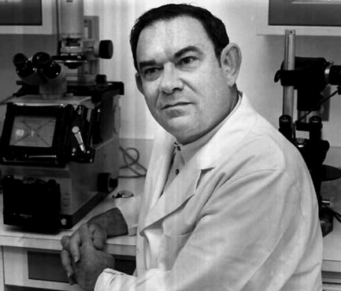
Leonard Hayflick
Notes:
Studying about how cells kept dividing and then they died and then discovered The Hayflick Limit

Slide 10
Hayflick Theory
DNA gets shorter with every replication
Human cells stop dividing then die
Quit dividing after about 50 divisions
If put in a freezer could slow down or stop
When warmed up it knows exactly where it left off and continually divide till the ending number
Notes:
DNA gets shorter with every replication

Slide 11
Hayflick Limit
Human cells have death programmed into them
Number of times cells can divide
Human division is 50 for human fetal cells

Slide 12
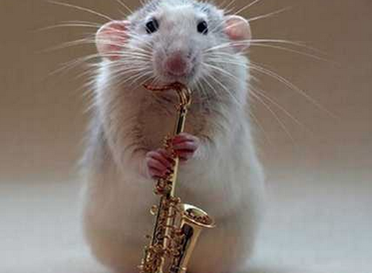
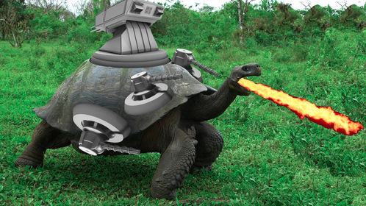
Mouse Tortoise Limit

Slide 13
Example of Hayflick limit
Mice – 14-28 divisions
Tortoise – 125 divisions
Make more duplicate cells as we get older
Studies show that people in their 80’s and 90’s Hayflick limit only divided 20 times
Cells have exp dates, which means we do too

Slide 14
What causes the limit?
Chromosomes
Human cell quit dividing after completely replicating its telomeres
Little caps of non coding DNA at the ends of each chromosome protecting it from genes errors and copying
Every time a cell is divided the telomeres get a tiny bit shorter each time
Notes:
Cell reaches its Hayflick limit when the telmoere gets so short and no longer protect the chromosome and the cell becomes unviable (not capable of working).
Why don’t biologist keep adding telemerase to the cells so they can keep dividing forever?
One cell does that very well which is called cancer

Slide 15
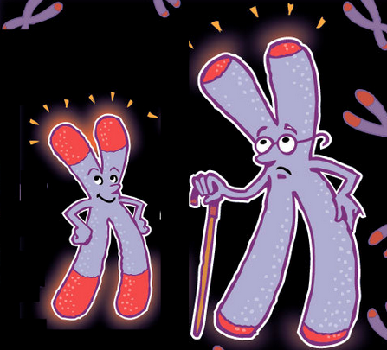
Notes:
Example of chromosomes that are young and old

Slide 16
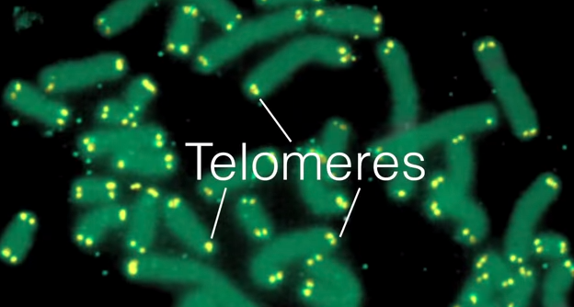
Notes:
Lets get detailed with the ends of each chromosome. These are called Telmeres

Slide 17
Telomeres
Most cells in the body contain 23 pairs of chromosomes, which carry our DNA.
At the ends of each chromosome is a protective cap called a telomere.
Each time a cell divides, the telomeres are snipped shorter,
Until eventually they stop working and the cell dies or goes into a suspended state called "senescence"
Notes:
The process is behind much of the wear and tear associated with ageing.

Slide 18
Cancer Cells
Constantly divide
Can sometimes create their own telomerase
Can do this so they can keep replicating without their cells getting damaged
Which is why they divide like crazy to become tumors
That’s why we don’t get injected with telomerase
Notes:
Thoery that program cell death evolved in order to keep our tissues from turning into cancerous growths
Raising levels of telomerase in people might slow the ageing process, but it makes the risk of cancer soar.

Slide 19
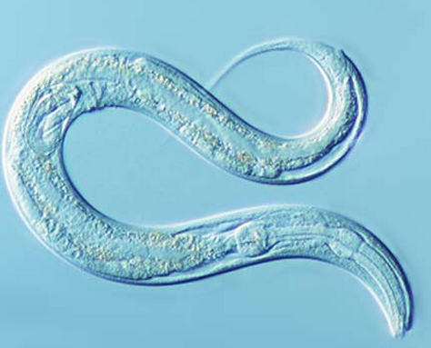
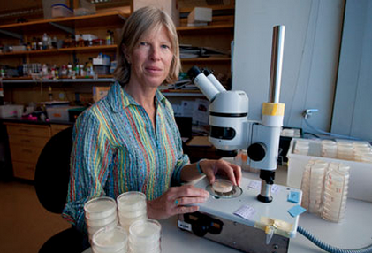
Research focus
Elegans – nemotodes
Lifespan is 14 days
Notes:
Cynthia kenyan discovered there was just 1 gene making these worms age called DAF-2 – mutated it so it would work and the worms lived for 28 days instead of 14. We could live 2 times longer if they found a way for us. She discovered DAF-16 that has the opposite role. It keep worms young and healthy by regulates antioxidants, germ fighting proteins to fight off patogens and the effects of stress.
Aging genes resicted the effects of longevity gene Daf-16. When Daf-2 is damaged , daf-16 does its job., keeping woorms young.

Slide 20
Calories
We need calories to work but it is also stimiulating the aging process
Lower caloric intake leads to longer lifespan in mice and other animals
Calories stimulate IGF-1 and stimulates aging
Direct food energy toward growth
Take fewer calories makes you maintain instead of grow
Notes:
Strengthen against stress and disease from taking for calories. Metalbism shift gears if eating a lot or eating less
Tough to do studies on long living animals because it takes forever for them to die

Slide 21
Positive
Diet
Exercise
Be positive
Have a social life
Negative
Smoking
Alcohol
Consumption of chemical
Breathing chemicals
Notes:
Negative – smoking
Ultraviolet exposure

Slide 22
References
(n.d.). Retrieved June 6, 2015, from http://www.ibioseminars.org/kenyon/lecture_notes_part_1.pdf
(n.d.). Retrieved June 6, 2015, from http://www.washingtonpost.com/wp-srv/national/horizon/june98/microbes.htm
(n.d.). Retrieved June 6, 2015, from http://www.theguardian.com/science/2010/nov/28/scientists-reverse-ageing-mice-humans
(1998, December 27). Retrieved June 6, 2015, from http://news.bbc.co.uk/2/hi/health/241864.stm
A roadmap to end aging. (n.d.). Retrieved June 6, 2015, from http://www.ted.com/talks/aubrey_de_grey_says_we_can_avoid_aging.html
Can someone simply die of 'old age'? (2010, September 19). Retrieved June 6, 2015, from http://www.washingtonpost.com/wp-dyn/content/article/2010/09/18/AR2010091803509.html
DAF-16: Aging Gene Governs Lifespan In Humans? (n.d.). Retrieved June 6, 2015, from http://www.science20.com/news_articles/daf16_aging_gene_governs_lifespan_humans
Live Long and Proper: Genetic Factors Associated with Increased Longevity Identified. (n.d.). Retrieved June 6, 2015, from http://www.scientificamerican.com/article.cfm?id=genetic-factors-associated-with-increased-longevity-identified
Mortality. (n.d.). Retrieved June 6, 2015, from http://www.radiolab.org/2007/jun/14/
https://www.dropbox.com/s/efs947wj8fg6ayl/cellphysvideo.mp4?dl=0

Slide 23

Positive/Negative Video

